Slide 1




NEXT GEN EMPLOYABILITY PROGRAM
Creating a future-ready workforce
Team Members
College Name:Arunachala college of engineering for women
Student Name :RV Ajina
Student ID : au960221104012

Slide 2

CAPSTONE PROJECT SHOWCASE
Project Title
Car Rentals Application with Django Framework
Abstract | Problem Statement | Project Overview | Proposed Solution | Technology Used | Modelling & Results | Conclusion

Slide 3
Abstract
The car rental industry is a vital component of modern transportation services, offering individuals and businesses convenient access to vehicles for various purposes. Developing an efficient and user-friendly car rental application can streamline the rental process, improving customer experience and optimizing rental business operations. This project aims to create a comprehensive car rentals application using the Django web framework, leveraging its robust features and scalability.
Source :

Slide 4
Problem Statement
Problem Statement:
The car rental industry faces challenges in efficiently managing rental operations, including vehicle inventory, customer bookings, and administrative tasks. Existing rental systems may lack user-friendly interfaces, robust features, and scalability, hindering the rental process and impacting customer satisfaction. Therefore, there is a need for a comprehensive car rentals application that addresses these challenges and provides a seamless experience for both customers and rental businesses.
The goal of this project is to develop a car rentals application using the Django web framework to address the following key problems:
Poor User Experience
Inefficient Rental Management
Source :

Slide 5
Project Overview
Project Overview: Car Rentals Application with Django Framework
Introduction
2.Technology Stack
3.Key features
4.Architectural overview
5.Development process
6.Implementation details
7.Testing approach
8.Development
9.Future enhancement
10.conclusion
Source :

Slide 6
Proposed Solution
.
The proposed solution is to develop a comprehensive car rentals application using the Django framework, which will address the challenges faced by both customers and rental businesses in the car rental industry. The application will offer a user-friendly interface, robust features, and efficient management tools to streamline the rental process and enhance the overall user experience.
Source :

Slide 7
Customers will be able to register, login, and manage their accounts securely.
Rental businesses will have administrative controls to manage user accounts and permissions.
User Authentication and Management:
2..Rental Booking System:
Customers can select rental dates and make reservations for available cars.
Availability calendars will be displayed to indicate the availability of cars for specific dates.
Source :

Slide 8
The proposed solution aims to deliver a modern, efficient, and user-friendly car rentals application that meets the needs of both customers and rental businesses. By leveraging the Django framework and best practices in software development, the application will offer a robust and scalable solution for the car rental industry.
Source :

Slide 9


Technology Used
Front-end
Back-end
Source :

Slide 10
Modelling & Results
Define Models:
Start by defining the necessary models to represent different entities in the application. These include:
Car: Represents individual cars available for rental.
Customer: Represents users who rent cars.
Rental: Represents rental bookings made by customers.
Run Migrations:
After defining models, run Django migrations to create corresponding database tables.
Result:
With the models defined and migrations applied, you now have the necessary database structure to store car, customer, and rental data.
Source :

Slide 11
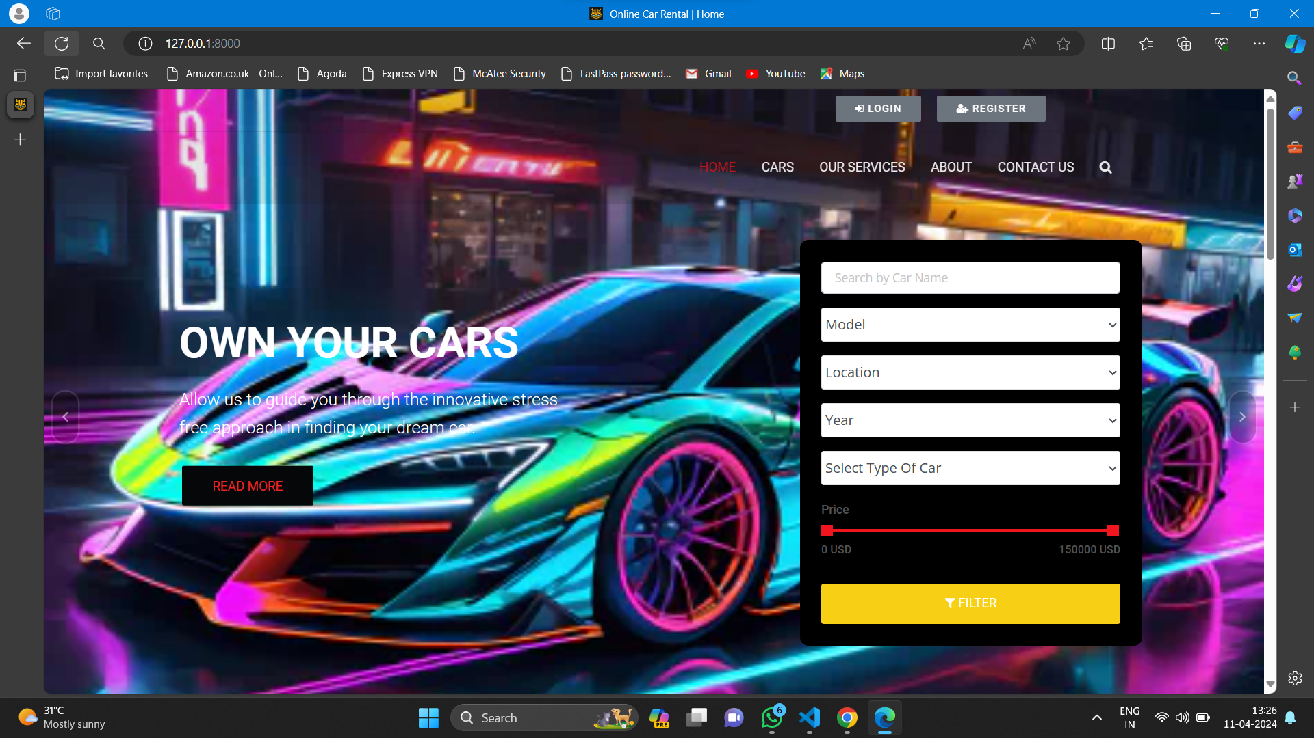
Homepage

Slide 12
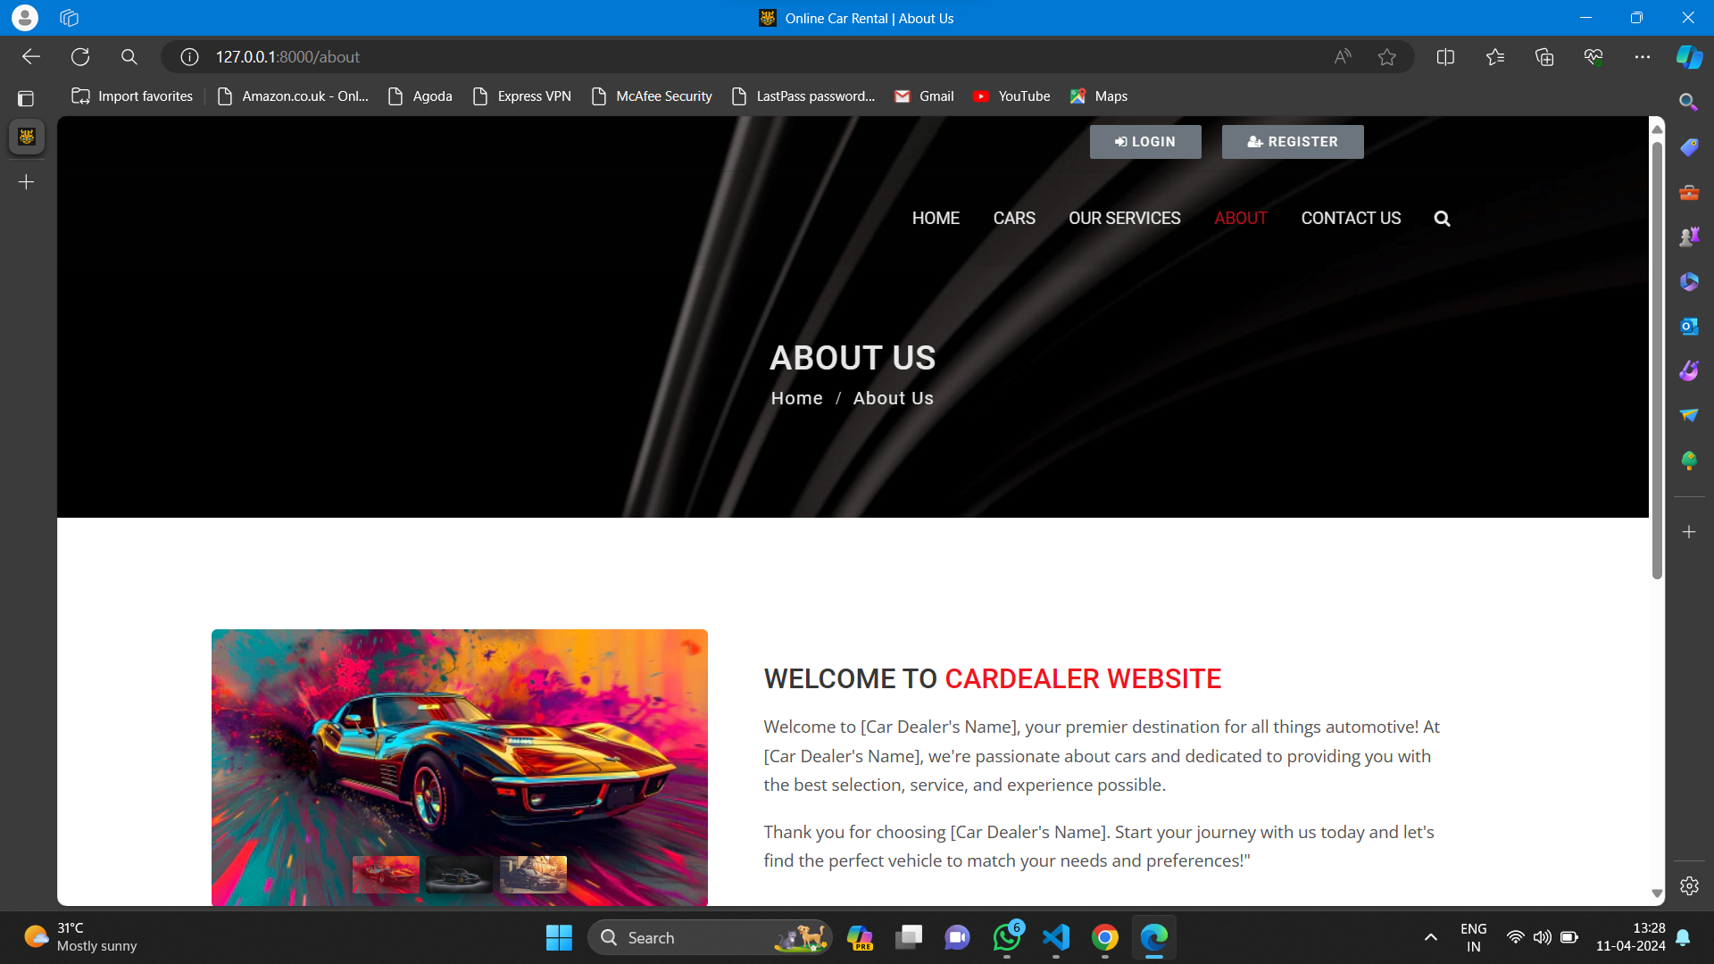
About-Us-Page

Slide 13
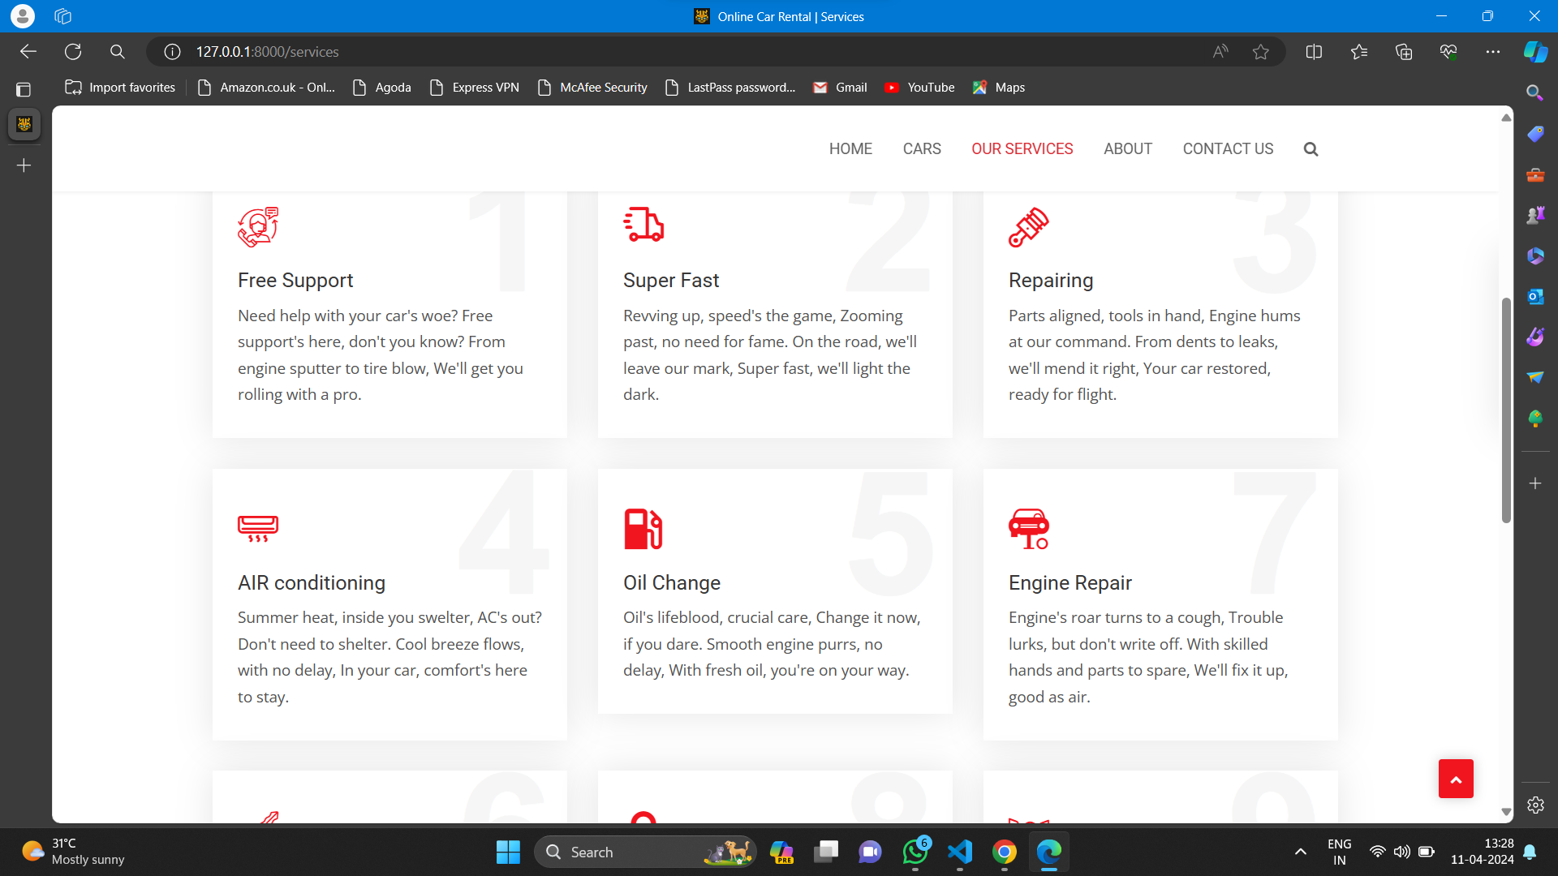
Service-Page

Slide 14
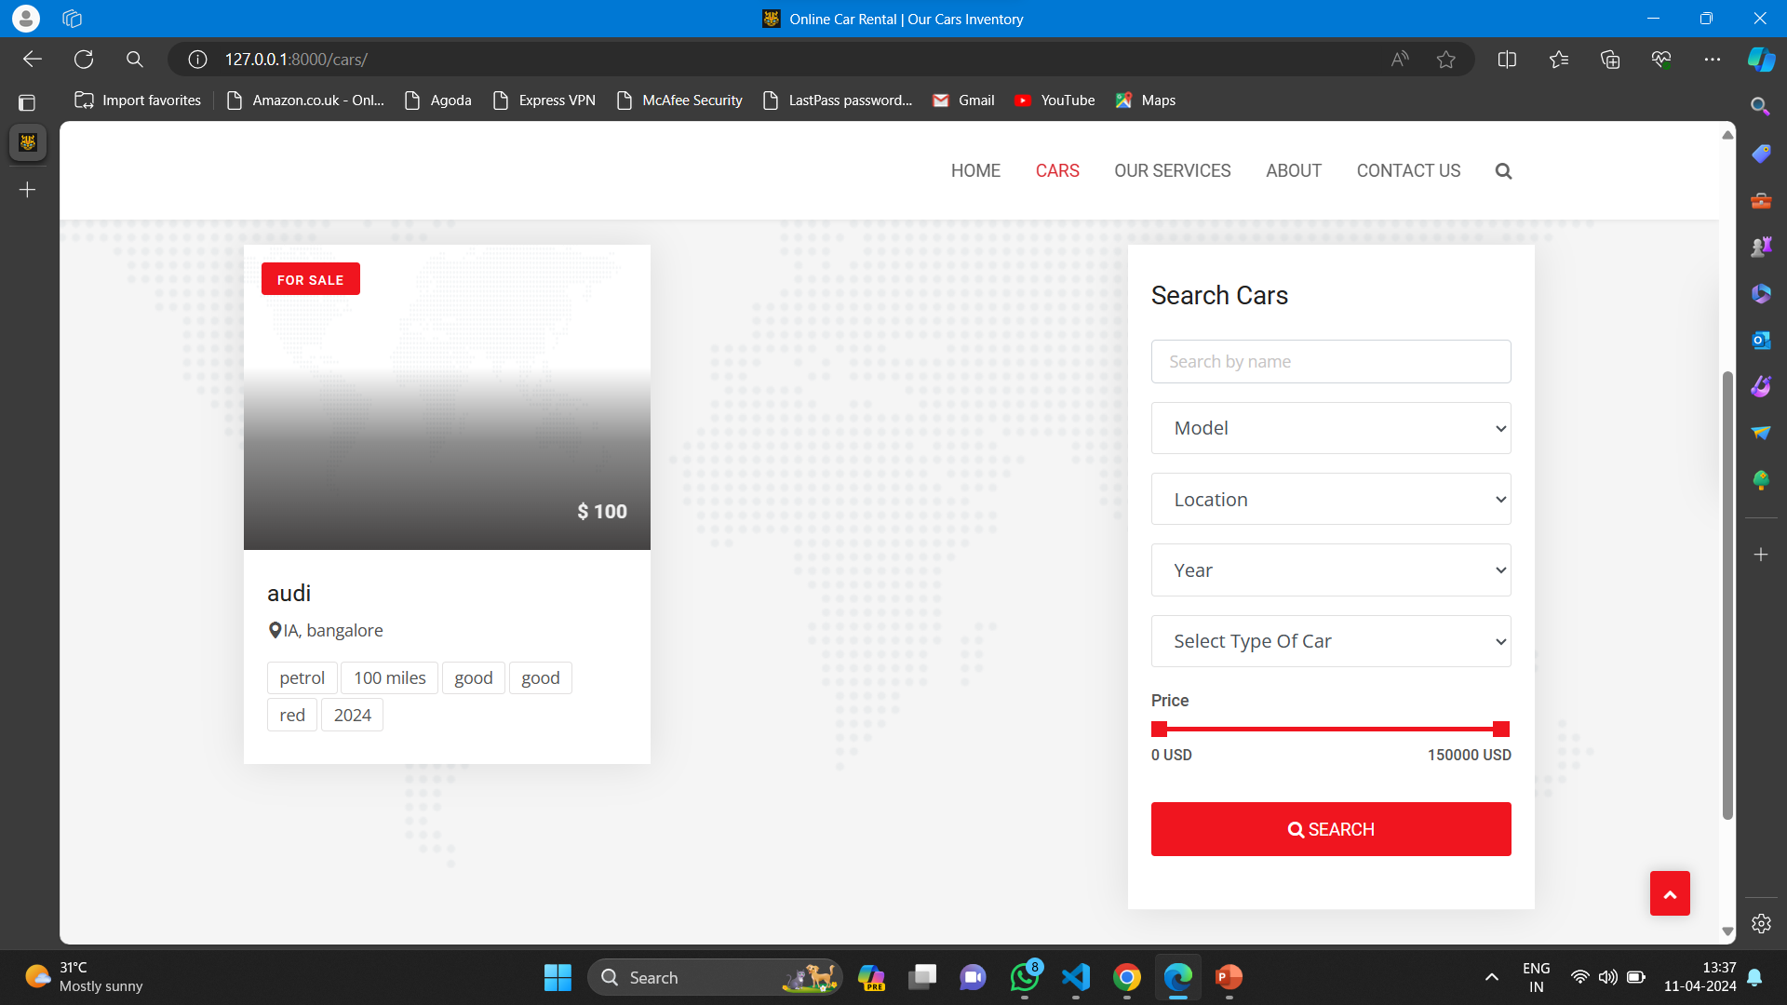
Cars-Page

Slide 15
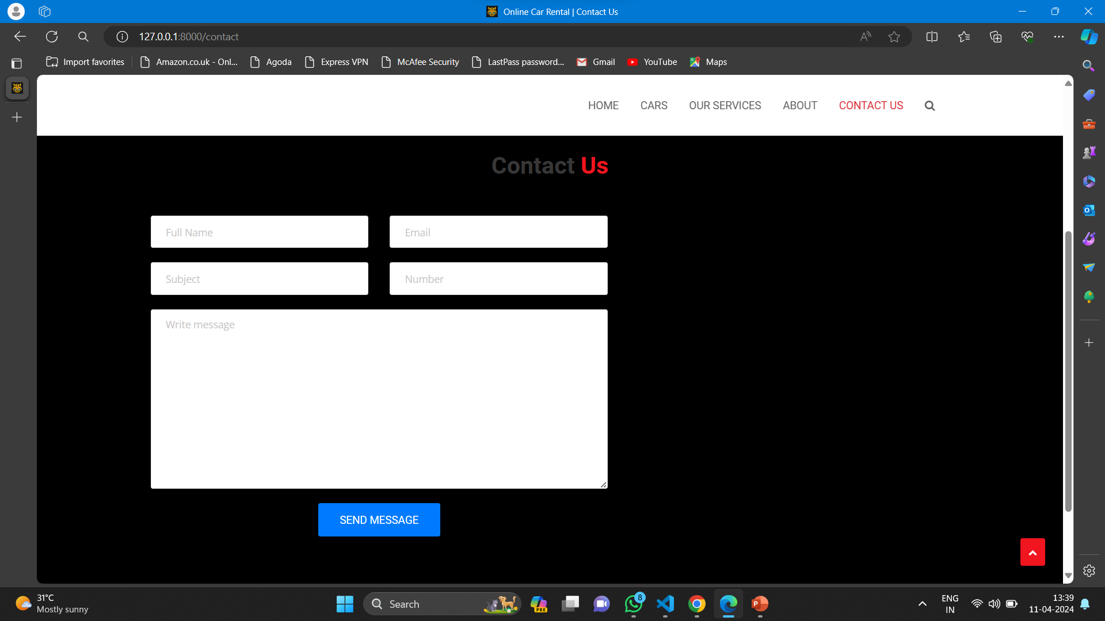
Blog-Page

Slide 16
Future Enhancements:
Integration with third-party APIs for additional features such as payment processing, geolocation services, and vehicle tracking.
Implementing advanced analytics and reporting features for rental businesses.
Enhancing the user interface with interactive elements and modern design trends.
Optimizing performance and scalability to handle larger volumes of data and users.

Slide 17
Conclusion
The car rentals application aims to revolutionize the rental industry by providing a modern and efficient platform for both customers and rental businesses.
Through the use of Django framework and best practices in software development, the application offers a robust and scalable solution to meet the demands of the car rental market.
Source :

Slide 18
Thank You!
Notes:
Thank You !!

